Slide 1



Oklahoma City University
Masters in Computer Science
PROJECT
ON
Sales Prediction in the Tourism Industry
Under the guidance of
Tashfeen, Ahmad
Mathematics & Computer Science
BY:
Akhila Mediboyina
Id: B00115521

Slide 2

INTRODUCTION
DATASET OVERVIEW
DATA PREPROCESSING TECHNIQUES
IMPLEMENTATION HIGHLIGHTS
CONCLUSION
CONTENTS

Slide 3
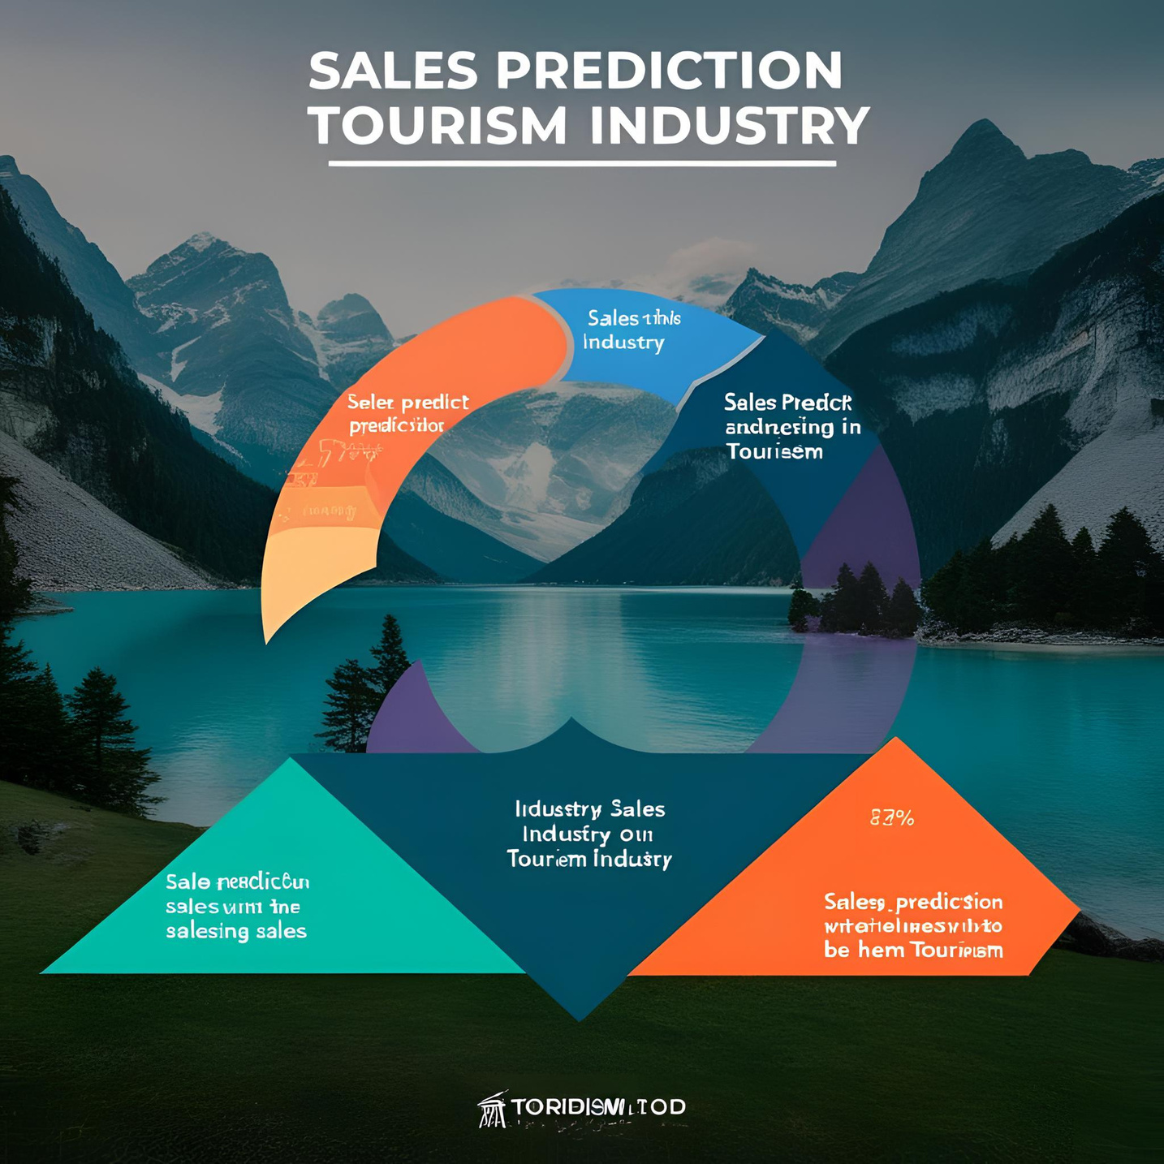
INTRODUCTION
OBJECTIVE: Our project focuses on sales prediction in the tourism industry, leveraging historical booking and sales data to forecast future trends. By employing advanced machine learning models, we aim to empower stakeholders with actionable insights to optimize revenue, enhance customer experiences, and plan resource allocation effectively.
FOCUS AREAS: Handling missing values, encoding categorical variables, normalizing numerical data, and preparing data for predictive modeling

Slide 4
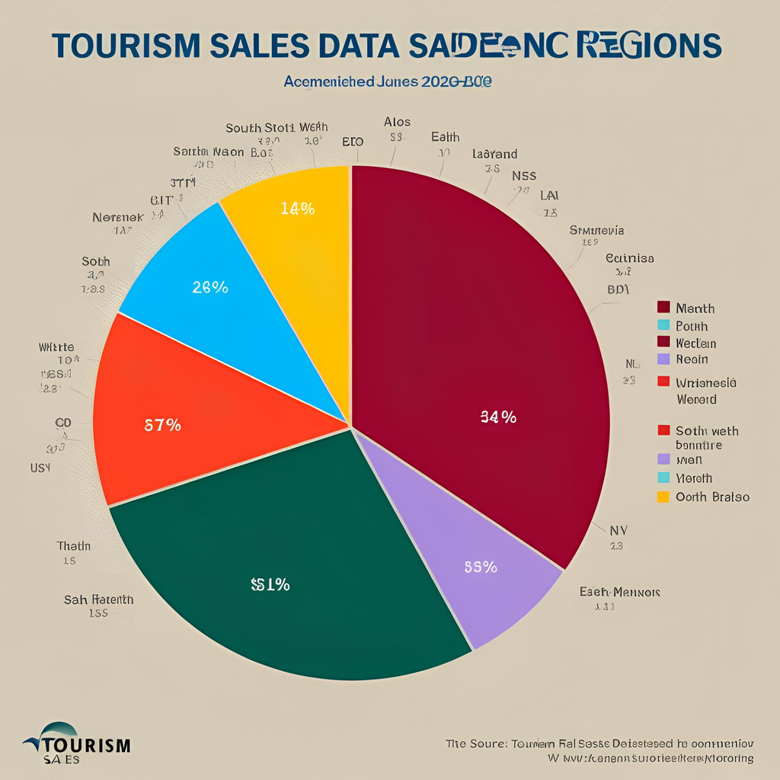

DATASET OVERVIEW
Tourism Sales Data Across Regions
Collector(s): Kaggle, World Tourism Organization (UNWTO), Government Tourism Boards
Year Range: 2010–2024
Dataset Title: "Tourism Sales Data Across Regions"
Version Number: v1.2
Publisher: Kaggle, UNWTO, government tourism department
Challenges in Raw Data:
Presence of missing values affecting data integrity
Categorical data requiring conversion into numerical format
Different scales in numerical attributes leading to inconsistencies

Slide 5

DATA PREPROCESSING TECHNIQUES
Preparing Data for Sales Prediction
Handling Missing Values:
Identifying and replacing missing values using appropriate strategies (mean, median, mode)
Ensuring data completeness to improve prediction accuracy
Encoding Categorical Variables:
Transforming non-numeric data into numerical form using techniques like Label Encoding and One-Hot Encoding
Normalizing Numerical Data:
Standardizing features to ensure uniform data distribution for better model performance
Ensuring Data Quality:
Removing duplicate records and inconsistencies
Balancing the dataset to prevent bias in predictions

Slide 6

IMPLEMENTATION HIGHLIGHTS
Key Steps in Data Preprocessing
Loading and Cleaning Data:
Read dataset and check for missing values
Fill missing values with forward-fill or imputation techniques
Transforming Data:
Encode categorical variables (e.g., Region, Tourism Type)
Normalize numerical features (e.g., Sales, Revenue)
Validating Preprocessed Data:
Visualizing data distributions before and after transformations
Ensuring dataset is ready for predictive modeling

Slide 7
CONCLUSION
Summary & Next Steps
Key Takeaways:
Preprocessing is critical to improving prediction accuracy
Proper handling of missing values and scaling ensures data consistency
Transforming categorical data enables seamless model training
Next Steps:
Feature engineering to extract additional insights
Applying machine learning algorithms for sales prediction
Evaluating model performance using suitable metrics

Slide 8


